Slide 1


KCCEMSR, THANE​
Simulation and Analysis of Antenna used for AR/VR technology
For the Degree of Bachelors of Electronics & Telecommunication
Tanmay Chimankar Mayur Mane Mitesh Sawant Vaishnavi Wadkar
Roll No: 05 Roll No: 30 Roll No:49 Roll No:59
Guided by : Anupama Chaurasia (Asst Professor EXTC )
Department of Electronics & Telecommunication Engineering K. C. College of Engineering & Management Studies & Research, Thane (E) 04/10/2024

Slide 2
KCCEMSR, THANE​
Introduction
Patch Antenna
The patch antenna is a popular choice for AR VR devices, characterized by its compact size, lightweight, and good performance at the desired frequencies.
Compact and Lightweight: The small form factor is ideal for integration into portable and wearable devices.
Easy to Fabricate: Patch antennas can be printed on PCBs, making them cost-efficient for mass production.

Slide 3
KCCEMSR, THANE​
Problem Statement
Designing antennas for AR/VR devices presents unique challenges, such as the need for small size, low power consumption, and high data rates. Additionally, antennas must be integrated into the form factor of AR/VR devices, often with limited space availability.
Older AR/VR devices used Monopole antennas, Dipole antennas and Helical antennas which had Lower efficiency compared to more modern antennas. Larger size than patch antennas. Limited gain, more complex design and requires precise construction for optimal performance.
Newer devices use advanced antennas like Beamforming Antenna, MIMO Antenna and mm Wave, offering faster data rates, lower latency, and better support for 5G.
Designing antennas against human body is always challenging due to body effects, including de-tuning effects, attenuation effects, and shadowing effects.

Slide 4
KCCEMSR, THANE​
Literature Survey
Topics
Technology
Year
AR VR technology in Education.
Display Technology: OLED, LCD, and MicroLED screens for high-resolution visuals.
FEBRUARY 2023
Evolution of AR VR Technology.
Tracking Systems: Inside-out and outside-in tracking using cameras.
APRIL 2023
Antenna design for 5g communication.
Connectivity: Wireless technologies like Bluetooth, Wi-Fi, and 5G for data transmission.
OCTOBER 2017
Design of rectangular microstrip patch antenna.
Haptics: Feedback systems for tactile interaction, like vibrations in controllers.
MARCH 2016
Ultra-Wideband MIMO Antennas: Latest Advances in Design and Technology.
Artificial Intelligence: AI for environment mapping, object recognition, and interaction enhancement.
AUGUST 2023
Sensors: Accelerometers, gyroscopes, and magnetometers for detecting head and body movements.
Antenna Artificial Intelligence: The Relentless Pursuit of Intelligent Antenna Design.
Optics: Lenses such as Fresnel lenses and waveguides to focus and guide light into the eyes.
OCTOBER 2022

Slide 5
KCCEMSR, THANE​
7. Design of a Compact Transparent ​
Antenna for 5GWireless Applications.​
​
The study employs transparent glass substrates and CST simulation software to achieve a lightweight, compact antenna with a wide frequency bandwidth for 5G systems.
AUGUST 2023​
8. Augmented-Reality Development Adaptor for Supporting AR glass.​
​
The ADA SDK leverages Unity's development framework to streamline AR content creation across diverse devices, enhancing compatibility and adoption in the AR market.
OCTOBER 2023​
9. Sub-Terahertz Microstrip Antenna​
Array for Future Communication.​
​
NOVEMBER 2023​
10. On the impact of VR/AR​
applications on optical transport ​
networks: First experiments with Meta​
Quest 3 gaming and conferencing ​
applications.​
​
SEPTEMBER 2024

Slide 6



KCCEMSR, THANE​
Proposed Solution
Antenna Selection
Selecting an appropriate antenna type based on the specific requirements of the AR VR device.
Simulation and Optimization
Utilizing simulation software to evaluate the performance of different antenna designs.
Prototype Development
Creating and testing a prototype of the antenna design to validate its performance in real-world conditions.

Slide 7
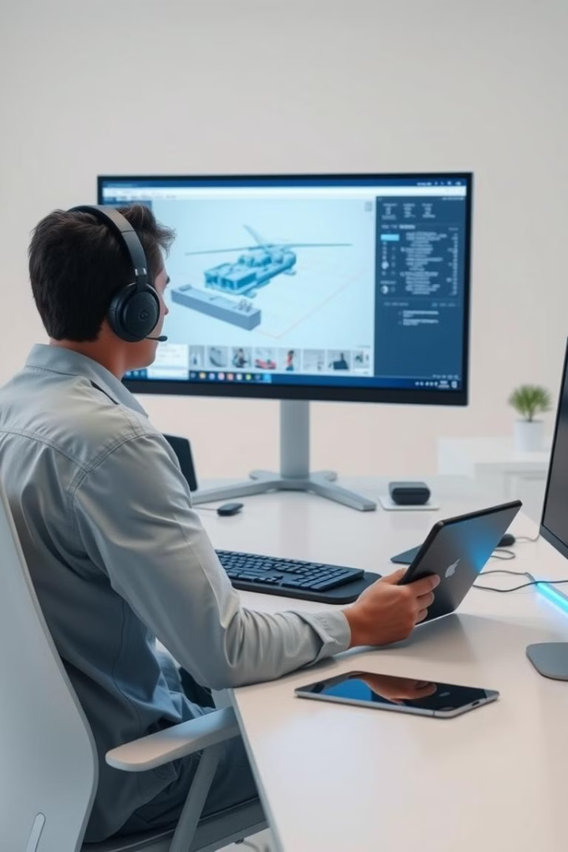


KCCEMSR, THANE​
Hardware and Software Requirements
Software
HFSS 13 .
For in future HFSS 18 and 19.
Measurement Equipment
Vector network analyzer, spectrum analyzer, and antenna test chamber for validating antenna performance.

Slide 8
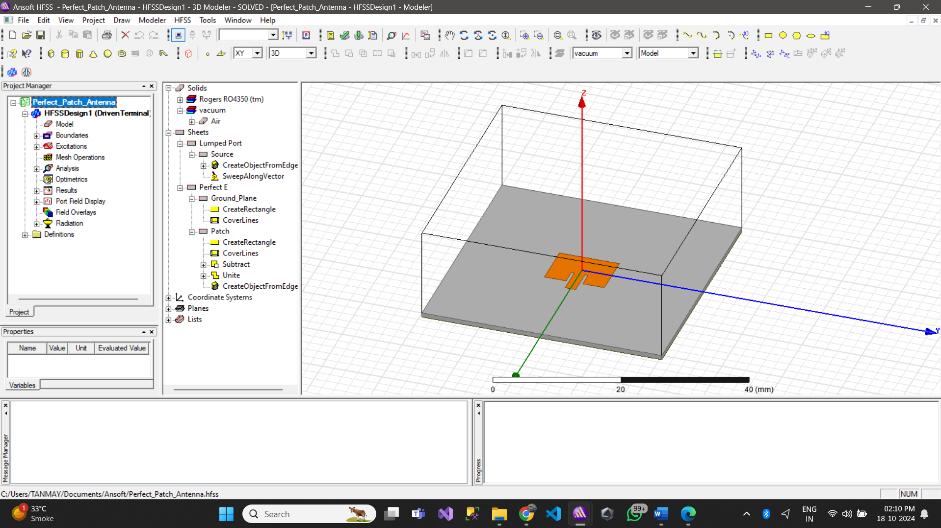
KCCEMSR, THANE​
Design

Slide 9
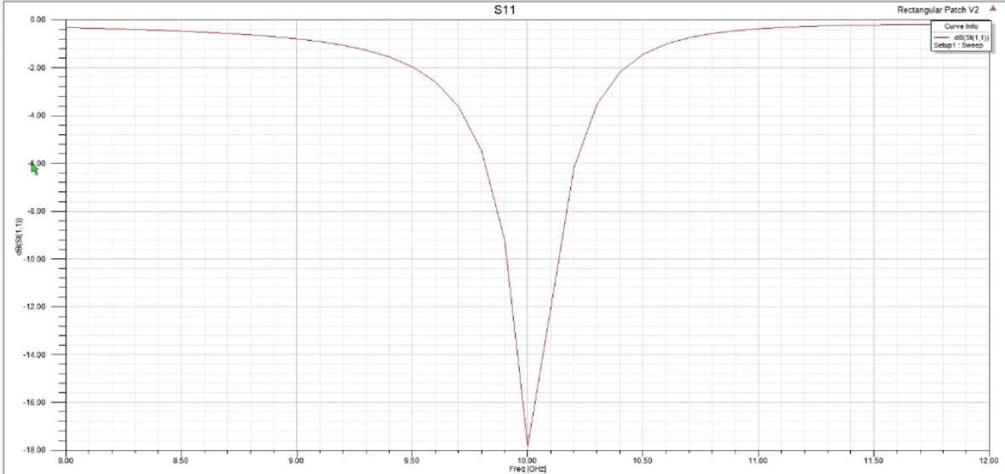
KCCEMSR, THANE​
XY Plot S11 Parameter

Slide 10
KCCEMSR, THANE​
Components
PARAMETERS
Resonant Frequency : 1 - 6 GHz
Dielectric Constant (εr): 4.4 mm
Dielectric Height (h): 1.6 mm
Width (W): 4 cm
Length (L): 4 cm

Slide 11
KCCEMSR, THANE​
Conclusion
Patch antenna are crucial for enabling seamless AR VR experiences.
Further research and development will focus on miniaturization, integration, and enhanced signal processing.
By optimizing antenna design and performance, AR VR technologies can provide more immersive and realistic experiences.

Slide 12
KCCEMSR, THANE​
Acknowledgements
We would like to express our sincere thanks and deep sense of gratitude to K. C. College of Engineering & Technology and Management Studies & Research for giving us an opportunity to integrate the learning from this graduate course. ​
We take this opportunity to express our profound gratitude and regards to our guide, Head of the Electronics and Telecommunication Department, Dr. Baban U. Rindhe and Guide Anupama Chaurasia for his exemplary guidance, monitoring and constant encouragement throughout our project work titled “SIMULATION AND ANALYSIS OF ANTENNA USED FOR AR VR TECHNOLOGY” and also thanks to Department Faculty & Technical staff members for their time to time help for our project work.​

Slide 13
KCCEMSR, THANE​
References
[1] Author 1: Tira Nur Fitria Institut Teknologi Bisnis AAS Indonesia, "Augmented Reality (AR) and Virtual Reality (VR) Technology in Education", International Journal of Computer and Information System (IJCIS) Peer Reviewed – International Journal Vol : Vol. 04, Issue 01, February 2023.
[2] Author 1: Amit Thampan, Author 2: Adil Razak, Author 3: Abhay. K, Author 4: Akash. R, Author 5: Manu. M, "Evolution of Augmented Reality (AR) and Virtual Reality (VR)", International Journal of Research Publication and Reviews, Vol 4, no 4, pp 5449-5454, April 2023.
[3] Author 1: P.W. Futter, Author 2: J. Soler, "Antenna design for 5g communications", 2017 Sixth Asia-Pacific Conference on Antennas and Propagation (APCAP), Publisher: IEEE
[4] Author 1: Houda Werfelli, Author 2: Khaoula Tayari, Author 3: Mondher Chaoui, Author 4: Mongi lahiani, Author 5: Hamadi Ghariani, "Design of rectangular microstrip patch antenna" Published in: 2016 2nd International Conference on Advanced Technologies for Signal and Image Processing (ATSIP)
[5] Author 1: Subhash B K, Author 2: Rajashekhar C Biradar, Author 3: Tanweer Ali, "Ultra-Wideband MIMO Antennas: Latest Advances in Design and Technology", Published in: 2023 Second International Conference on Trends in Electrical, Electronics, and Computer Engineering (TEECCON)
[6] Author 1: Weiping Dou, Author 2: Yuandong Tian, Author 3: Geng Ye; Author 4: Jiang Zhu, "Antenna Artificial Intelligence: The Relentless Pursuit of Intelligent Antenna Design", Published in: IEEE Antennas and Propagation Magazine ( Volume: 64, Issue: 5, October 2022).

